Slide 1




Adrienne Shulman
AVP, Business Systems
ashulman@csod.com
@age_shulman

Slide 2

DevOps is critical to my organization because _________.
Diversity & Inclusion is critical to my organization because _________.
3 tactics I can bring back to my organization to advance D&I:
1. __________________________________
2. __________________________________
3. __________________________________

Slide 3




Our industry has a diversity problem
Typical reasons organizations start D&I journeys:
Social pressure.
Social justice.
Talent market demands it.
Spark innovation.

Slide 4
Our 2 year journey embedding Diversity, Equity & Inclusion into all aspects of our engineering department
Commit
Research
Pre-launch checklist
Diversity of voices
Get To Work
50+ people working across 6 committees:
Recruiting/Onboarding
Training & Development
Mentoring
Events
Performance
Data
Sustain & Scale
Chief Diversity Officer leading company wide DEI strategy
Departmental Inclusion councils
2019
2020
2021
ashulman@csod.com
@age_shulman

Slide 5


Lesson 1: Leadership Commitment Matters
PRE-LAUNCH CHECKLIST
Don’t rush to get busy, slow down before you speed up.
WORDS INVITE ACTION
Public commitment inspires people to take action.

Slide 6



Lesson 2: Sell The Why Your challenge: Find the why unique to your organization.
DIVERSITY INCREASES TEAM INTELLIGENCE
INCLUSION INCREASES PARTICIPATION
JUSTICE & EQUALITY THE RIGHT THING TO DO

Slide 7


Lesson 3: Create a Learning Culture Your goal is to change behavior. Not in one individual but an entire organization.
TRAINING Expensive but easy
LEARNING Free but difficult
Outside experts
Unconscious bias training
Inclusive Leadership
Continuous Learning Mindset
Social learning (slack, internal social channels)
Ask Me Anything, Lunch & Learn, Coffee Chats, Team Meetings
Resource Group Panel Discussions

Slide 8


Lesson 4: Doing More Is Easier
THINK BIG
SHIFT LEFT

Slide 9
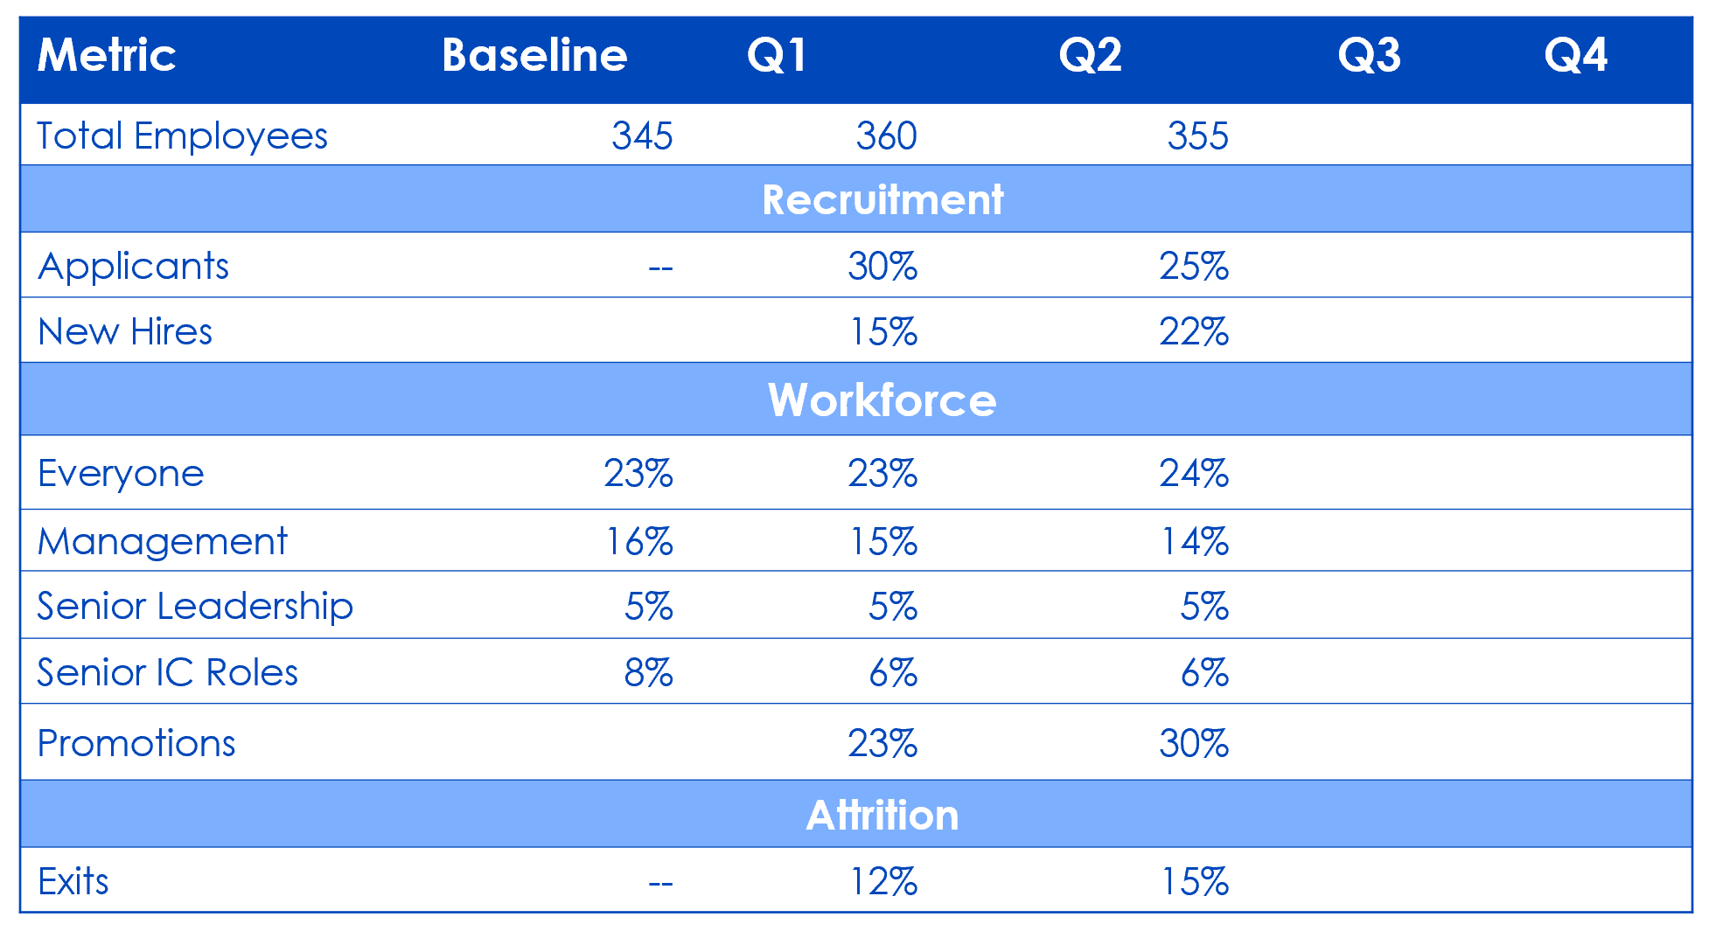
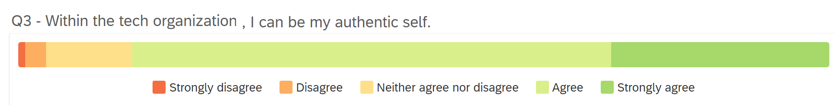
Lesson 5: Data, duh
sample diversity report:
Transparency builds trust.
Use flow dynamics to understand how diversity moves into and out of a system.
For every effort you take to increase diversity, take 2 to increase inclusion.
sample inclusion survey:

Slide 10
Summarize
1. LEADERSHIP COMMITMENT MATTERS
2. SELL THE WHY
3. CREATE A LEARNING CULTURE
4. DOING MORE IS EASIER
5. DATA, DUH
BONUS: BUCKLE UP AND BE PATIENT

Slide 11
How do I know it’s working?

Slide 12



Leaders remain committed
Employee engagement
Company Culture
79/100
Our executive team demonstrates a commitment to improving DEI globally
3X
Women on executive leadership team increased from 10% to 30%.
100%
Hiring managers commit to prioritizing DEI at step 1 of recruiting.
4
Times per year CTO reviews diversity reports with senior leadership.
+25
Highest employee rating for Inclusive Leadership out of all new manager training, 25 points higher than our target.
83/100
I am confident in my managers ability to lead a culturally diverse team.
200+
Volunteers advancing inclusion via our internal allies network.
35%
Participation in Employee Resource Groups
Anecdotes to support:
Psychological Safety
The Future of Work is Flexible
Outcomes > Output
Remote First/Distributed Work
Inclusive Meeting Practices

Slide 13
Here’s the help I’m looking for
I believe our entire industry is better with more Devops and more Diversity & Inclusion. More equitable, more interesting, more productive, and happier.
You are a leader. You are an influencer. Spend your political capital. Make your organization more diverse and inclusive.
ashulman@csod.com
@age_shulman

